Slide 1
Chapter 8 shift registers
移位寄存器

Slide 2
Registers 寄存器
A n-bit register is a set of n flip-flops that is capable of storing n bits of binary information.
With added combinational gates, the register can perform data-processing tasks.
Some basic data movements are show on the next page.

Slide 3
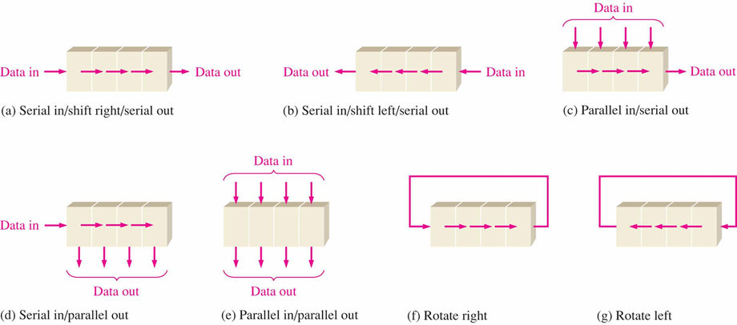

Slide 4
Shift Register
A register capable of shifting its stored bits laterally in one or both directions is called a shift register.
The logical configuration of a shift register consists of a chain of flip-flops in cascade, with the output of one flip-flop connected to the input of the next FF.

Slide 5
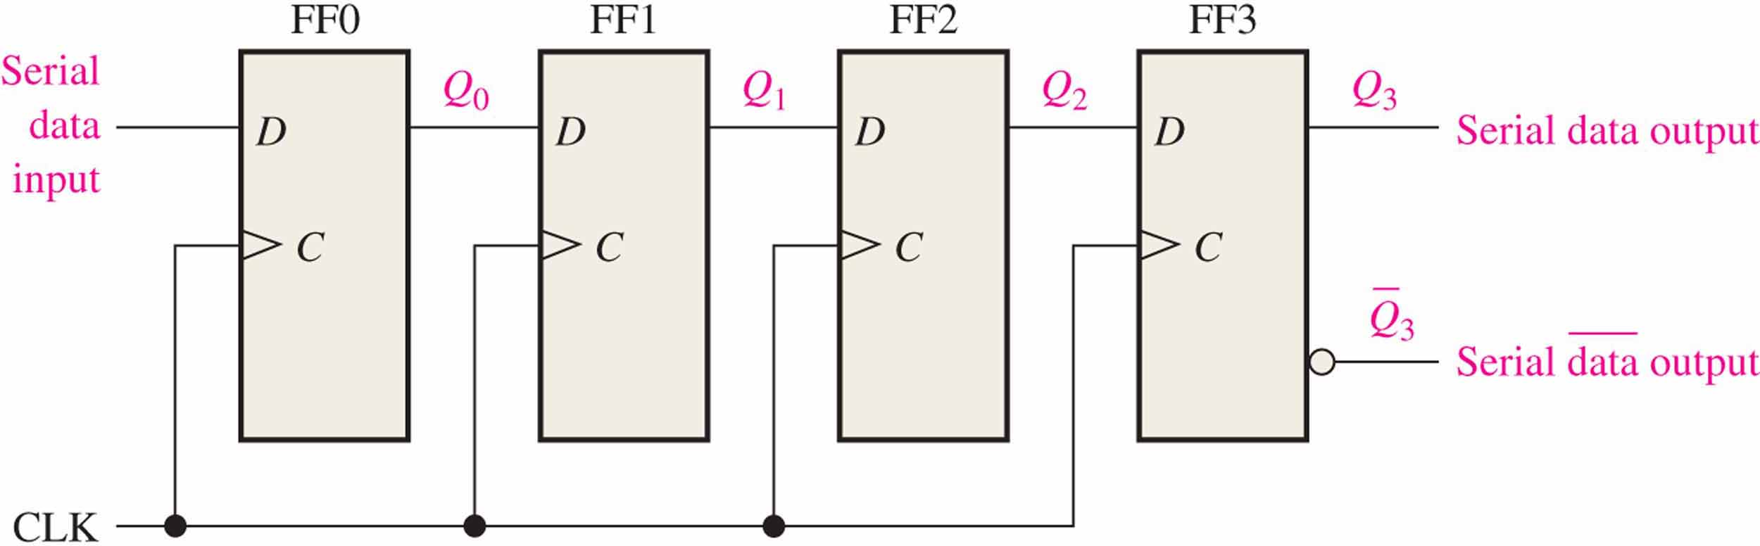
Serial-in/Serial out Shift Register 串行输入/串行输出移位寄存器
The figure shows a 4-bit device implemented with D flip-flops.

Slide 6
Serial-in/Serial out Shift Register
E.g. four bits(1101) is entered serially into the register.
MSB
LSB
The bits must be shifted out serially and taken off the Q₃
0 | 0 | 0 | 0
Clock 1
0 | 0 | 0 | 1
1101
Clock 2
0 | 0 | 1 | 1
101:0
How to get the data out of the register?
Clock 3
0 | 1 | 1 | 0
01:00
Clock 4
1 | 1 | 0 | 1
1:000

Slide 7
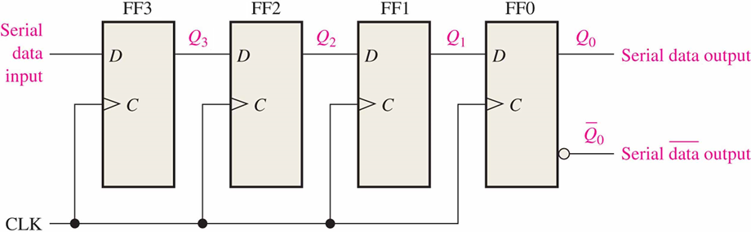
Serial-in/Serial out Shift Register 串行输入/串行输出移位寄存器
The figure shows a 4-bit device implemented with D flip-flops.

Slide 8
Serial-in/Serial out Shift Register
E.g. four bits(1101) is entered serially into the register.
MSB
LSB
0 | 0 | 0 | 0
1101
1 | 0 | 0 | 0
Clock 1
0:110
0 | 1 | 0 | 0
Clock 2
00:11
1 | 0 | 1 | 0
Clock 3
000:1
1 | 1 | 0 | 1
Clock 4

Slide 9
serial in/parallel out shift register 串入并出寄存器
parallel out

Slide 10
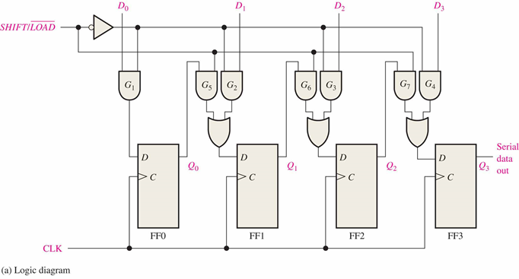
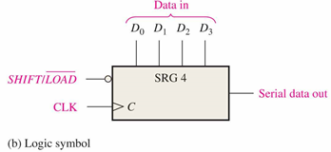
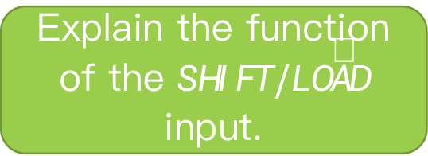
Parallel in/Serial out Shift Register 并入串出寄存器
Shift registers can be used to convert parallel data to serial form. A logic diagram for this type of register is shown:
Explain the function of the $SHIFT/\overline{LOAD}$ input.

Slide 11
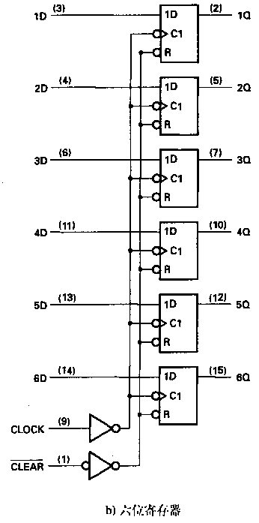
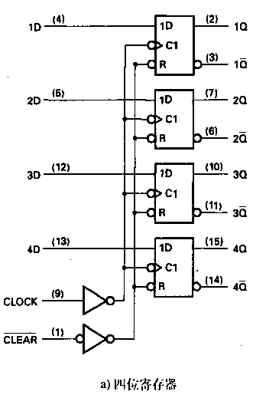
Parallel in/parallel out
4-bit register
6-bit register

Slide 12
Registers with parallel load
Next page shows a 4-bit register with a control input Load that is directed through gates into the D inputs of the flip-flops.
When Load is 1, the data on the four inputs is transferred into the register with the next positive transition of a clock pulse.
When Load is 0, the data inputs are blocked, and the D inputs of the flip-flops are connected to their outputs.

Slide 13
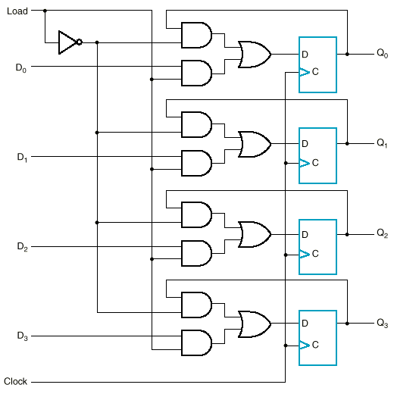

Slide 14
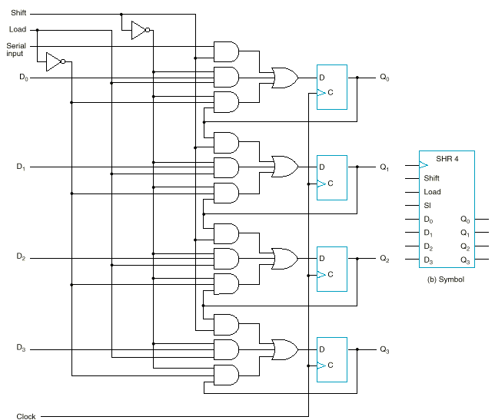
Shift register with parallel load
Shift | Load | Operation
0 | 0 | Nothing
0 | 1 | Load parallel
1 | X | Shift

Slide 15
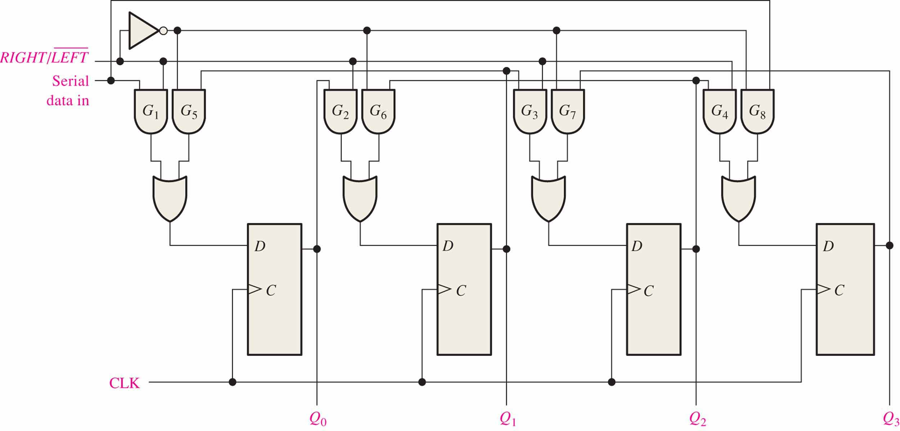
Bidirectional Shift Register
Bidirectional shift registers can shift the data in either direction with the control input.

Slide 16
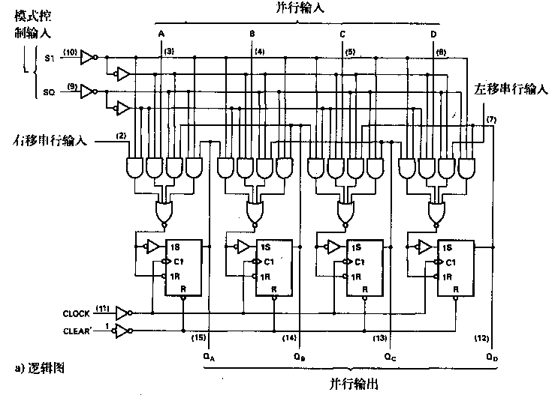
Universal Shift Register 通用移位寄存器
S₁S₀ | Action
00 | Nothing
01 | Shift down
10 | Shift up
11 | Parallel load
(SN74XX194)

Slide 17
Shift Register Counters
Shift registers can form useful counters with the output of the last flip-flop fed to the input of the first, making a "circular" or "ring" structure.
Two important shift register counters are the Johnson counter and the ring counter.

Slide 18
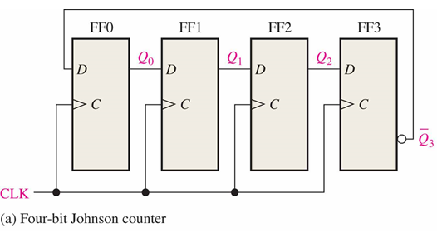
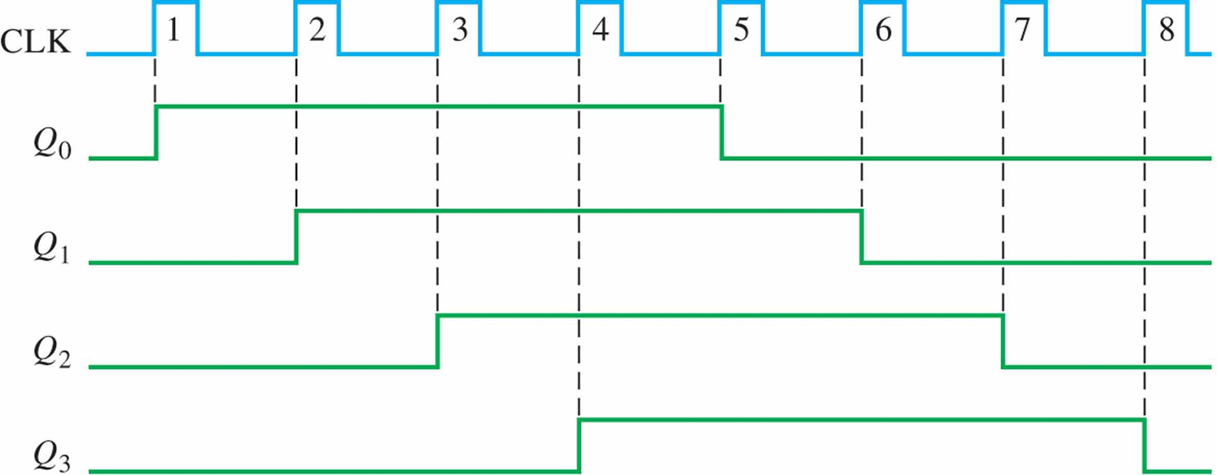

Johnson counter
The Johnson counter can be made with a series of D flip-flops or with a series of J-K flip flops.
$$f_{Q_{i}}=\frac{1}{2n}f_{clock}$$

Slide 19
Johnson counter
Johnson counter
State | Q₀ | Q₁ | Q₂ | Q₃
0 | 0 | 0 | 0 | 0
1 | 1 | 0 | 0 | 0
2 | 1 | 1 | 0 | 0
3 | 1 | 1 | 1 | 0
4 | 1 | 1 | 1 | 1
5 | 0 | 1 | 1 | 1
6 | 0 | 0 | 1 | 1
7 | 0 | 0 | 0 | 1
0 | 0 | 0 | 0 | 0
The Johnson counter is useful when you need a sequence that changes by only one bit at a time but it has a limited number of states (2n, where n = number of flip-flops).
The table shown here is for a 4-bit Johnson counter initialized with all 0.

Slide 20
Johnson counter
“twist”
Redrawing the same Johnson counter (without the clock shown) illustrates why it is sometimes called as a “twisted-ring” counter(also called switch-tail ring counter, walking ring counter,).

Slide 21
Ring counter 循环计数器，或环形计数器
A 4-bit ring counter constructed from a series of D flip-flops.

Slide 22
Ring counter
Straight ring counter
State | Q0 | Q1 | Q2 | Q3
0 | 1 | 0 | 0 | 0
1 | 0 | 1 | 0 | 0
2 | 0 | 0 | 1 | 0
3 | 0 | 0 | 0 | 1
0 | 1 | 0 | 0 | 0
1 | 0 | 1 | 0 | 0
2 | 0 | 0 | 1 | 0
3 | 0 | 0 | 0 | 1
0 | 1 | 0 | 0 | 0
It must be preloaded with the desired pattern (usually a single 0 or 1) and it has even fewer states than a Johnson counter (n, where n = number of flip-flops.
The table shown here is for a 4-bit ring counter initialized with a single 1.

Slide 23
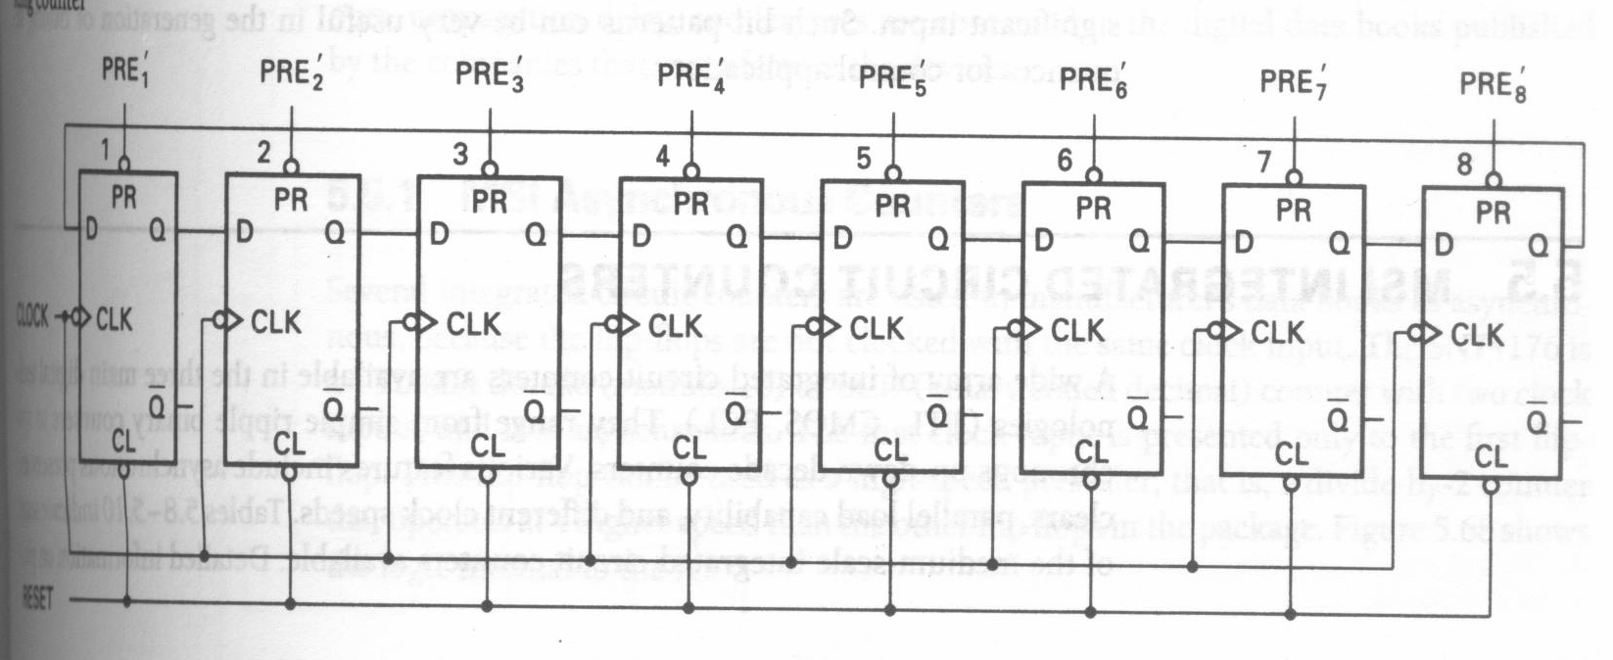
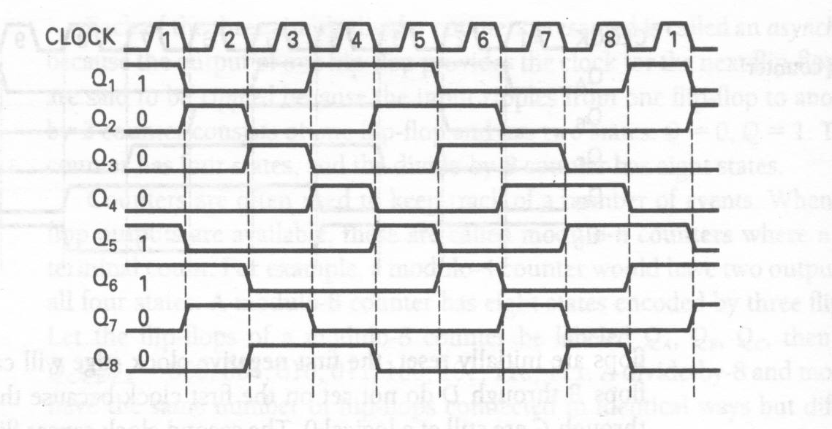
Ring counter
E.g. An 8-bit ring counter with a preload mode.
The preload mode is repeated every 8 clocks.
需要片数不同，表示状态不同

